Slide 1
Charged Particle in an Electromagnetic Field
by:Ahmad AliAhmad

Slide 2
TOC
Background
Important Equations
SympNet
PNN
PINN

Slide 3
Project Overview
Given the trajectory data of a charged particle in a electromagnetic field, we would like to predict its future states using:
SympNets
PNNs
PINNs

Slide 4


Slide 5
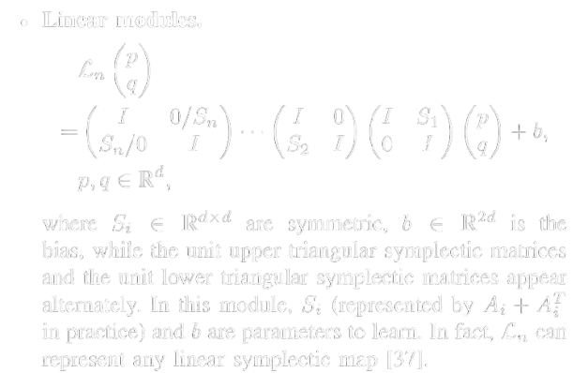
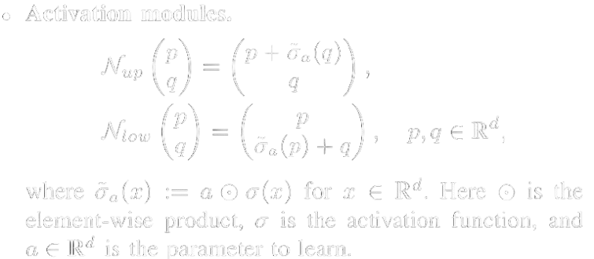
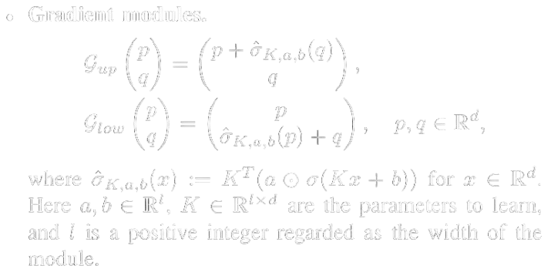
SympNet Architecture
01
LA-SympNet
02
G-SympNet

Slide 6
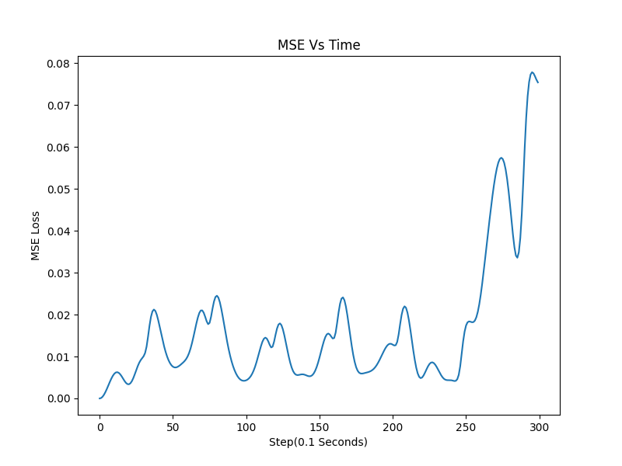
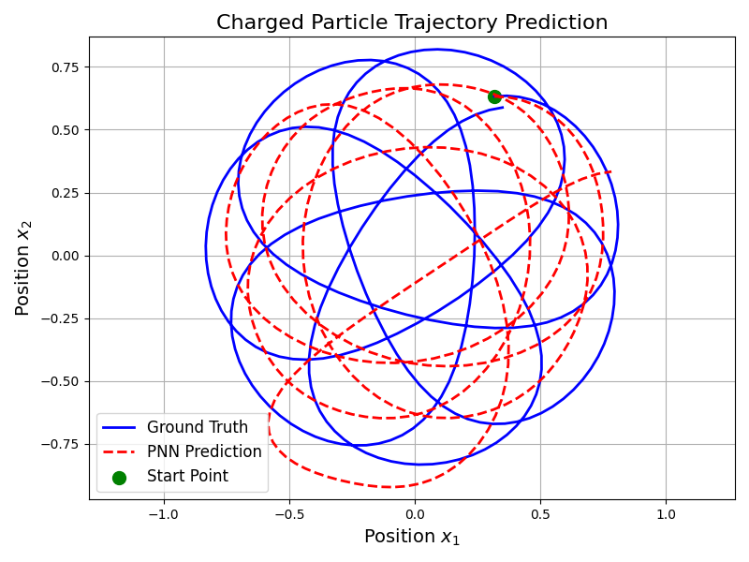
LA-SympNet Results

Slide 7
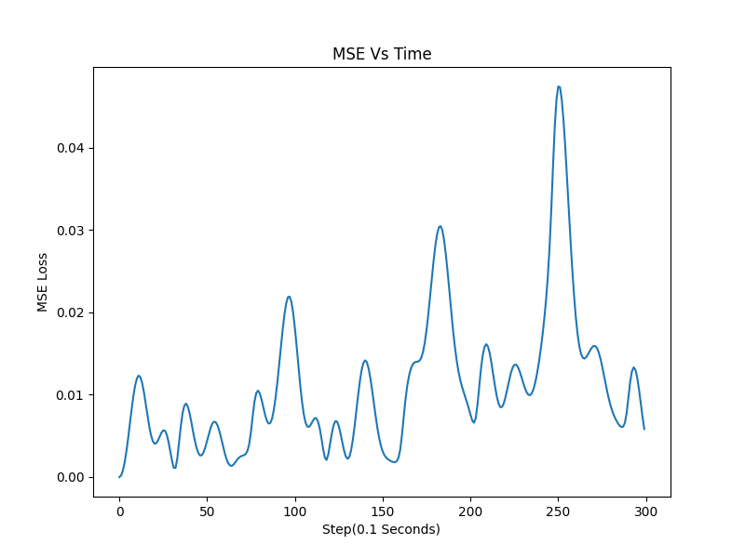
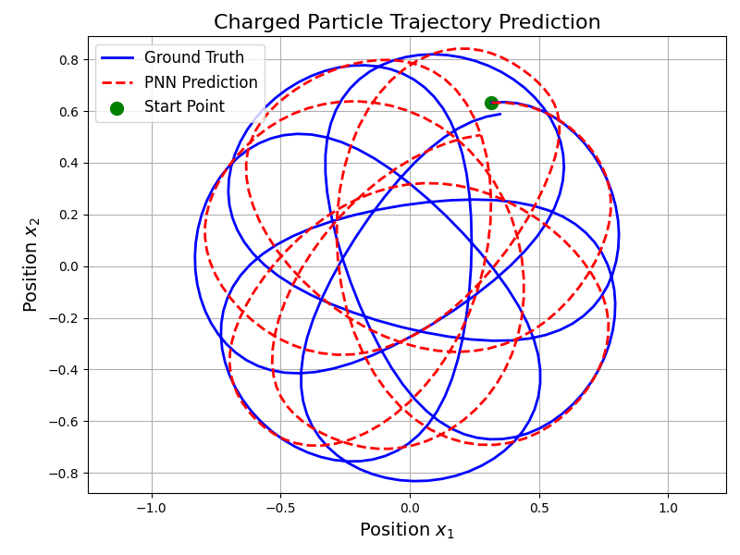
G-SympNet Results

Slide 8
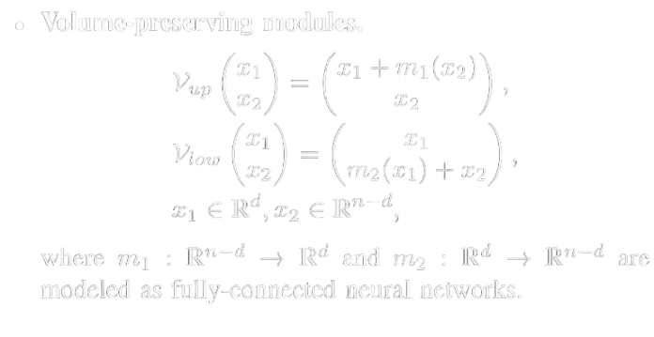
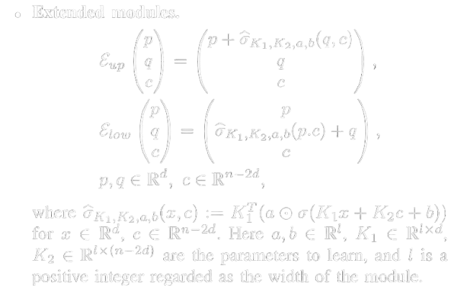
PNN Architecture
01
NICE
02
E-SympNet

Slide 9
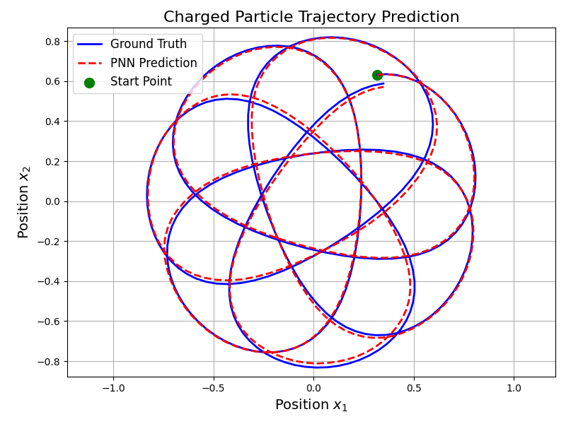
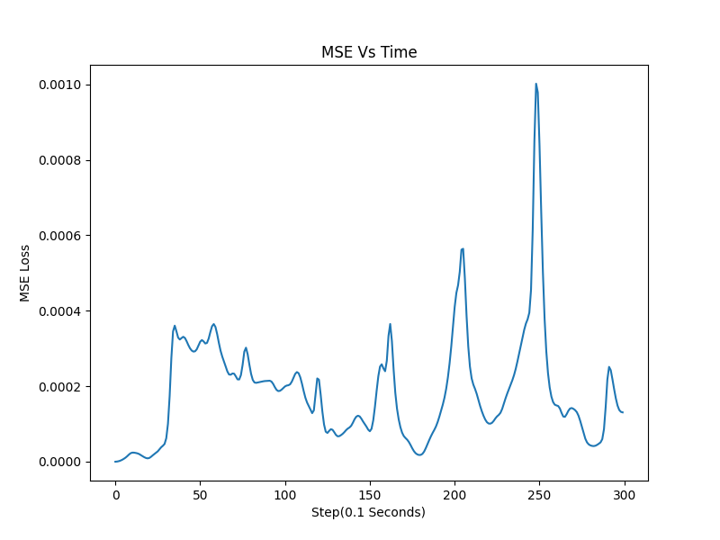
PNN Results

Slide 10

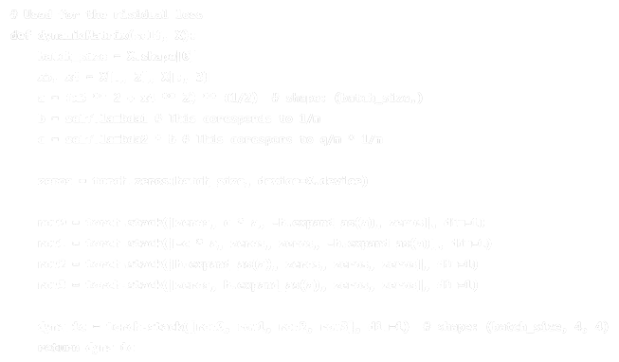
PINN Architecture

Slide 11
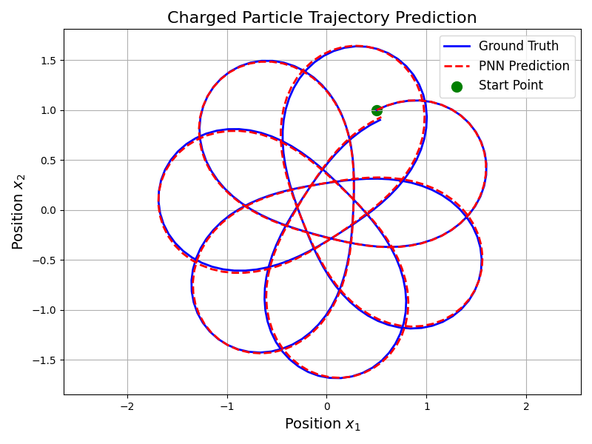
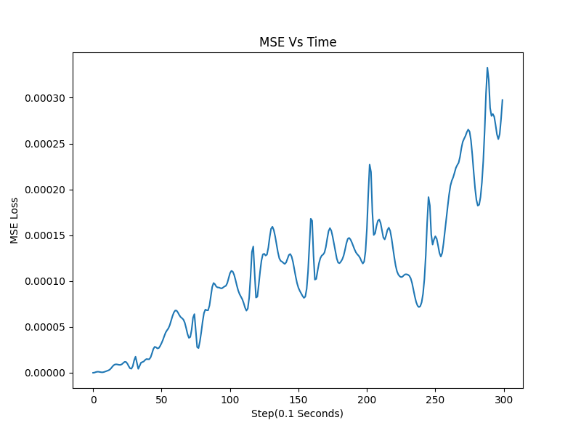
PINN Results

Slide 12
Thank You!

